Slide 1
Jermyn Borough Council Meeting
11/17/22

Slide 2
Meeting Agenda
November 17, 2022
CALL TO ORDER
PLEDGE OF ALLEGIANCE
ROLL CALL
PREVIOUS MEETING MINUTES
TREASURER REPORT/BILLS PAYABLE
CORRESPONDENCE
PUBLIC COMMENT
CHURCH PRESENTATIONS
GARBAGE CONTRACT
PROFESSIONAL REPORTS
POLICE
FIRE
SOLICITOR
CODE ENFORCEMENT
ZONING
ENGINEER
TAX COLLECTOR
MAYOR
COMMITTEE REPORTS
2023 BUDGET
RUSHBROOK CREEK EASEMENTS
INSURANCE RENEWAL
COMMUNITY REINVEST GRANT 2021-34
NEW BUSINESS

Slide 3
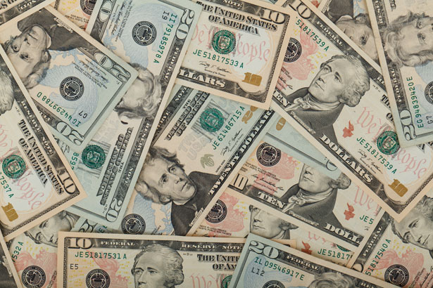
Treasurer’s report
11/17/22
ASSETS
Checking/Savings
Capital Reserve - DPW 10,727.54
Capital Reserve - Police 4,871.82
Crime Watch Fund 222.69
General Fund - Community 127,500.65
General Fund - FNB 5,894.76
Holiday Lights Fund 1,424.09

Slide 4
Treasurer’s report
Investment - General Fund 1,008.30
Investment - Liquid Fuels 34,042.85
Investment - Paving Fund 1,018.77
Investment - Recycling 5,037.27
Investment - Refuse 2,617.82
Liquid Fuels - FNB 5,689.72
Petty Cash 231.00
Recreations Fund 22,830.34
Recycling - Community 11,525.36
Refuse Checking - FNB 56,481.50
Total Checking/Savings 291,124.48

Slide 5
Treasurer’s report
200000 · Accounts Payable 21,930.92
Long Term Debt 245,665.90

